Slide 1
Edward Junprung
Jude Zhu
Solving the Jingle-Jangle Fallacy of the ESG Industry
Michael Liston
Victor Chen
Notes:
How long does each team have for the final presentation?
~12-13 minutes of presentation time (avg 1 min per slide), ~2-3 minutes of Q&A. Each team has a total of 15 minutes.
Instructions and Grading Rubrics: https://docs.google.com/document/d/1BggTSkdvjhFQg-b7DdfsGH8AS7vytP6nQuQCk2adxQs/edit
Presentation 1 https://docs.google.com/presentation/d/1i4DzvZejhd7SHrjqhlU_kCdCgTNmgm3fITxOtaxwey8/edit?usp=drive_link
Presentation 2 https://docs.google.com/presentation/d/1M919HHP7TbblCu_oUJM1QYREC8DJvoT3C013GgyVriU/edit?usp=drive_link

Slide 2
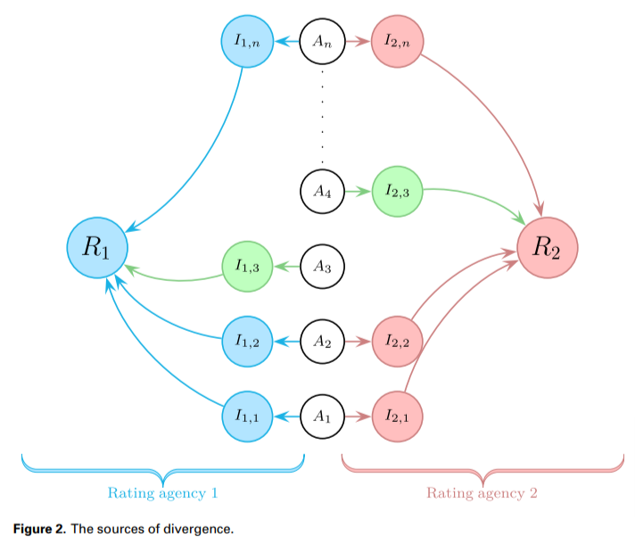
Problem Space
Opportunity:
Global ESG Assets: $50 trillion by 2025, one-third of the total managed assets
ESG reporting software market: $2.1 billion by 2023
Problem statement:
Different rating agencies use their own labels and measures, creating a jingle-jangle fallacy:
Difficult to categorize similar statements into the same standard
Difficult to compare ESG behaviors/performance across companies
Notes:
Victor
“Global ESG assets may surpass $41 trillion by 2022 and $50 trillion by 2025, one-third of the projected total assets under management globally.” - Bloomberg Intelligence
“The ESG reporting software market size was valued at $756.8 million in 2022, and expected to reach $2.1 billion by 2023” - Research and Markets.

Slide 3
Problem Space (cont’d)
Target Users: Anyone who needs an efficient approach to comparing companies against a standard framework of ESG topics
ESG investment analysts
ESG regulators
Impact: Replace labor cost for ESG labelling and comparing
~170 million/year for a large ESG rating agency, e.g., MSCI
Notes:
Victor

Slide 4
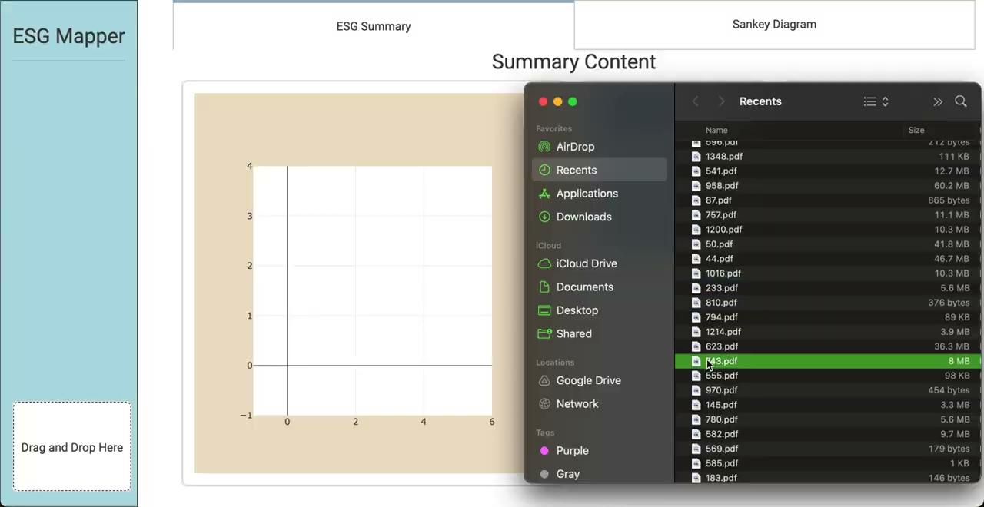
Solution Demo and User/Business Implications
Notes:
Michael - < 3 mins
Demo of your solution MVP / final deliverable to your target user: Demo your MVP or deliverable as if you are speaking to the target user. Discuss capabilities and features of the product as well as how these capabilities and features solve the pain points of your users. How does your MVP answer the key questions your target users have? What did target users say after seeing the demo (aka testimonial / user feedback)

Slide 5
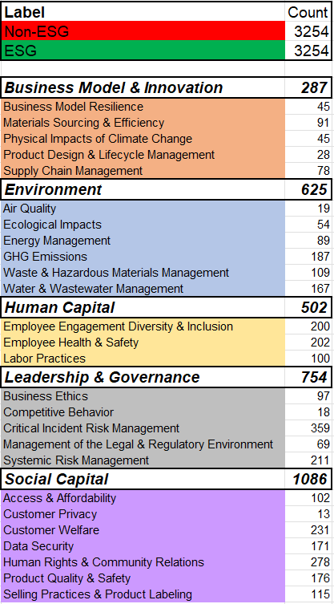
Training Data
Data
Non-ESG sentences are extracted from financial statements like 10-Q and 10-K reports using the SEC EDGAR Filings API
ESG sentences sourced from Sustainability Accounting Standards Board (SASB) compliant documents such as annual ESG reports
US only
37 SASB Reports and Disclosures (10 - 20 pages of sentences each)
Challenges
Class imbalance across different ESG categories
Manual labeling by domain experts restricts the volume of training data
Notes:
Edward
Following the goals that Michael mentioned, which is to categorize sentences in ESG documents to assess corporate ESG alignment, we collected two types of data:
The first type consists of non-ESG sentences, which are extracted from financial statements, such as the 10-K.
The second type comprises ESG sentences, which are sourced from SASB-compliant documents like annual ESG reports. And we limited our data to US-based SASB reports for consistency.
On the right, you can see the distribution of our training data. The main challenge we faced was class imbalance across categories. For example, 'Competitive Behavior' (indicated by the red arrow) is mentioned much less frequently compared to more mainstream topics such as 'Human Rights.' Additionally, resolving this class imbalance proved difficult because it requires manual labeling by a domain expert to ensure high-quality results.

Slide 6
Technical Approach
BERT
Universal Sentence Encoder
Grouping
Business Model & Innovation
26 Child Labels
Access & Affordability
Business Ethics
Business Model Resilience
Competitive Behavior
Critical Incident Risk Management
Customer Privacy
Customer Welfare
Data Security
Ecological Impacts
Employee Engagement Diversity & Inclusion
…
Environment
Predicted
ESG
Human Capital
Text from Reports
Leadership & Governance
Social Capital
Predicted
Non - ESG
Notes:
Jude

Slide 7
Evaluation
Stage 1 - Filtering
(Binary: SASB or not)
Stage 2 - ESG Classification
(SASB 5 and 26 classes)
Pretrained model | Accuracy | Recall | Precision | F1
Rule-based | 0.61 | 0.78 | 0.61 | 0.54
bert_en_cased_L-12_H-768_A-12 | 0.91 | 0.90 | 0.93 | 0.91
experts_pubmed | 0.91 | 0.92 | 0.90 | 0.91
bert_en_uncased_L-12_H-768_A-12 | 0.91 | 0.90 | 0.92 | 0.91
experts_wiki_books | 0.91 | 0.90 | 0.92 | 0.91
google/electra_base | 0.91 | 0.88 | 0.93 | 0.91
bert_multi_cased_L-12_H-768_A-12 | 0.91 | 0.91 | 0.90 | 0.91
albert_en_base | 0.91 | 0.91 | 0.91 | 0.91
talking-heads_base | 0.91 | 0.91 | 0.91 | 0.91
small_bert/bert_en_uncased_L-12_H-768_A-12 | 0.90 | 0.90 | 0.91 | 0.91
small_bert/bert_en_uncased_L-4_H-256_A-4 | 0.88 | 0.88 | 0.89 | 0.88
google/electra_small | 0.87 | 0.80 | 0.94 | 0.87
 | SASB 26 Class | SASB 5 Class
 | Best F1 | Best F1
Rule-based | 0.31 | 0.34
SOTA (ESG-BERT*) | 0.38 | 0.57
1. BERT –> 2. Universal Sentence Encoder | 0.61 | 0.71
Notes:
Victor

Slide 8
Evaluation (Cont’d)
Stage 2 - ESG Classification
(SASB 5 and 26 classes)
 | Model 1: Universal Sentence Encoder
Category | precision | recall | f1-score | support | Train Samples
Social Capital - Data Security | 0.78 | 0.91 | 0.84 | 34 | 171
Environment - GHG Emissions | 0.70 | 0.89 | 0.79 | 37 | 187
Leadership & Governance - Systemic Risk Management | 0.83 | 0.71 | 0.77 | 42 | 211
Environment - Water & Wastewater Management | 0.74 | 0.79 | 0.76 | 33 | 167
Social Capital - Selling Practices & Product Labeling | 0.78 | 0.64 | 0.70 | 22 | 111
Social Capital - Human Rights & Community Relations | 0.63 | 0.79 | 0.70 | 56 | 278
Business Model & Innovation - Supply Chain Management | 0.65 | 0.69 | 0.67 | 16 | 78
Environment - Air Quality | 1.00 | 0.50 | 0.67 | 4 | 19
Leadership & Governance - Critical Incident Risk Management | 0.61 | 0.71 | 0.65 | 72 | 359
Leadership & Governance - Business Ethics | 0.59 | 0.68 | 0.63 | 19 | 97
Human Capital - Employee Engagement Diversity & Inclusion | 0.68 | 0.58 | 0.62 | 40 | 200
Social Capital - Customer Welfare | 0.51 | 0.70 | 0.59 | 46 | 231
Social Capital - Access & Affordability | 0.57 | 0.60 | 0.59 | 20 | 102
Human Capital - Labor Practices | 0.48 | 0.55 | 0.51 | 20 | 100
Environment - Energy Management | 0.70 | 0.39 | 0.50 | 18 | 88
Business Model & Innovation - Materials Sourcing & Efficiency | 0.64 | 0.39 | 0.48 | 18 | 91
Human Capital - Employee Health & Safety | 0.51 | 0.45 | 0.48 | 40 | 202
Environment - Waste & Hazardous Materials Management | 0.42 | 0.45 | 0.43 | 22 | 109
Leadership & Governance - Management of the Legal & Regulatory Environment | 0.60 | 0.21 | 0.32 | 14 | 68
Business Model & Innovation - Business Model Resilience | 0.50 | 0.22 | 0.31 | 9 | 45
Social Capital - Product Quality & Safety | 0.28 | 0.31 | 0.30 | 35 | 175
Business Model & Innovation - Physical Impacts of Climate Change | 0.33 | 0.22 | 0.27 | 9 | 45
Business Model & Innovation - Product Design & Lifecycle Management | 0.50 | 0.17 | 0.25 | 6 | 28
Environment - Ecological Impacts | 0.50 | 0.09 | 0.15 | 11 | 54
Leadership & Governance - Competitive Behavior | 0.00 | 0.00 | 0.00 | 4 | 18
Social Capital - Customer Privacy | 0.00 | 0.00 | 0.00 | 3 | 13
Class Imbalance
Not enough training data for each child class
Notes:
Victor

Slide 9
Technical Challenges
Challenge 3: Slow inference of LLM on the UI
Solution: Serving our inference endpoints via AWS Lambda.
03
Challenge 1: Scarcity of training data
Solution: Manual, human expert-labeled, curated training data that reflects the latest SASB standards (existing models were likely trained on outdated data)
01
02
Challenge 2: Inconsistent PDF document formatting!
Solution: NLTK + domain expertise-based heuristics to cleanse the data
Notes:
Edward
Now I’m going to talk about technical challenges.
The first challenge was a lack of publicly available training data, probably because a domain expert is required. We ended up manually labeling thousands of sentences ourselves.
The second challenge was the inconsistent formatting of PDF documents, especially tables, footnotes, and other elements which can ruin the integrity of the training data. And to mitigate this, we used NLTK combined with heuristics for data cleansing, but the results were just okay.
And finally, we encountered slow inference times, which resulted in a poor user experience. Michael alleviated this bottleneck by utilizing AWS Lambda functions, which have a quicker warm-up time, and by chunking sentences so that we can distribute the workload.

Slide 10
Future Extensions
Achieve better models with more training data and more fine-tuning
Improve the UI design and improve the speed for result generation
Add sentiment/ substantive scores on the statements into ESG scores
Notes:
Victor

Slide 11
Wrap-up
Unlock the power of NLP with the cutting-edge ESG mapper
Simplify text summarization and ESG categorization in a real-time web-based interface
Revolutionize ESG ratings in investment analysis by standardizing ESG categorization
Transform the way you navigate sustainability reporting
Notes:
Jude

Slide 12
Acknowledgements and Additional Resources
We thank Professors Daniel Aranki and Puya Vahabi for the guidance and the class section 9 for their constructive comments!
References:
Berg, F., Koelbel, J.F. and Rigobon, R., 2022. Aggregate confusion: The divergence of ESG ratings. Review of Finance, 26(6), pp.1315-1344.
Busco, C., Consolandi, C., Eccles, R.G. and Sofra, E., 2020. A preliminary analysis of SASB reporting: Disclosure topics, financial relevance, and the financial intensity of ESG materiality. Journal of Applied Corporate Finance, 32(2), pp.117-125.
Devlin, J., Chang, M.W., Lee, K. and Toutanova, K., 2018. Bert: Pre-training of deep bidirectional transformers for language understanding. arXiv preprint arXiv:1810.04805.
Mehra, S., Louka, R. and Zhang, Y., 2022. ESGBERT: Language Model to Help with Classification Tasks Related to Companies Environmental, Social, and Governance Practices. arXiv preprint arXiv:2203.16788.
SASB. 2023. Companies reporting with SASB Standards, accessible at https://sasb.org/company-use/sasb-reporters/.
Notes:
No presenter needed

