Slide 1
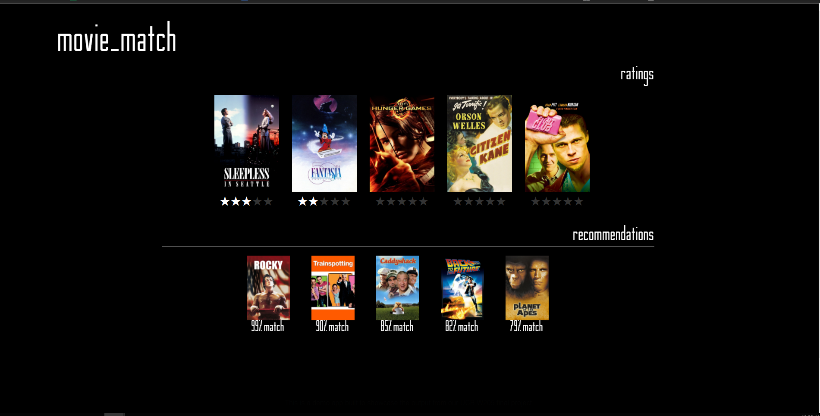
Movie Match
Cameron Bell
Luke Doolittle
Amod Ghangurde
Notes:
Cameron
Hi, we are Amod, Luke, and Cameron and we will be showing you our application Movie Match.

Slide 2
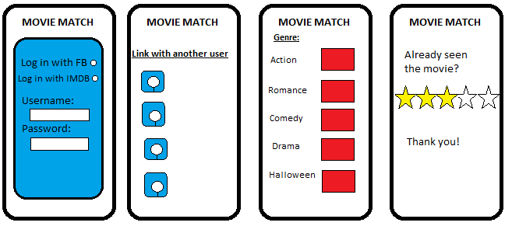
Overview
Problem statement
It takes far too long to choose a movie to watch
Even when you do choose, how do you know you’ll like it?
Movie Match hasn't been done successfully cross-platform
(s)
Notes:
Cameron
Imagine sitting down with two of your friends to watch a movie. I have spent as long as an hour before to choose a movie. Imagine if you could have an application suggest the perfect movie nearly instantaneously!
Movie match does just that. Based on a user’s ratings, it suggests movies to watch using a machine-learning recommender system.

Slide 3
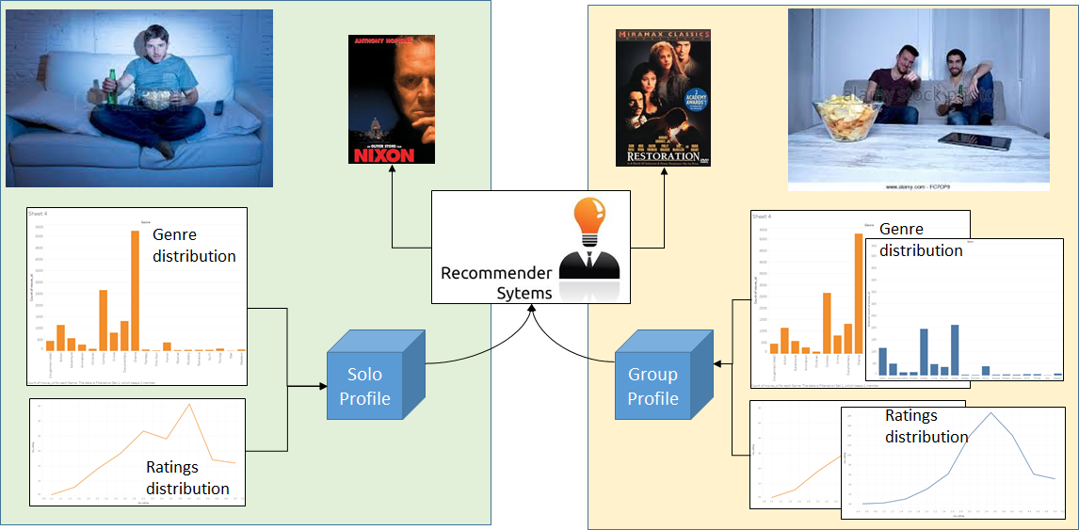
Solo and Group recommender
Notes:
Cameron
In the future, it will suggest movies for groups, as described. It will also suggest movies for a variety of genres, so you can watch something you’re in the mood for.
This could be implemented on a mobile platform as well, but right now is only on a web front end.

Slide 4
What we’ve done
Notes:
Cameron

Slide 5
Dataset
Dataset | Initial Load | Update
Source | GroupLens | Netflix prize
Ratings | 24 million | 100 million
Movies and Users | 40,000 movies by 260,000 users | 17,000 movies by 480,000 users
Timeframe | Jan, 1995 and Oct, 2016 | Oct, 1998 and Dec, 2005
Size | ~1Gb | ~2Gb
Format | .csv files | text files
Update (Near real time)
Updates made by users in the front end web application
Notes:
Cameron
Our data come from the Netflix Prize and from MovieLens, a research group with a similar goal.
3 Vs - Velocity, Volume, and variety
Velocity - Slow (right now). But in the future there will be incoming data from user ratings.
Volume - We have about 3 Gb of data initially
Variety - The incoming streaming data would be schema-on-read for easy processing, but the initial datasets required a fair amount of manipulation to use the machine learning model and to consolidate the two different forms.

Slide 6
Dataset
Preprocessing
Used Movielens dataset as base
Exact title and year match
After merging -> ~70 million Netflix ratings
Notes:
Luke

Slide 7
Architecture
Hardware Options
Physical systems
Virtual environment (EC2, Azure, etc)
Data Storage Options
Spark
Graph Database (Neo4j)
Machine Learning Options
Collaborative Filtering
Nearest Neighbors
Notes:
Luke

Slide 8
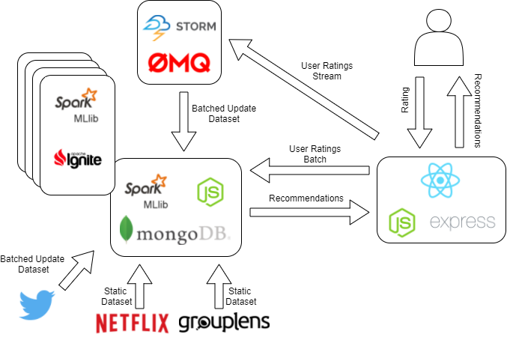
Architecture (Proposed)
Notes:
Luke

Slide 9
Architecture (Prototype)
Notes:
Luke

Slide 10
Requirements (for the given datasets)
Storage
> 10 GB storage
Memory
within Spark requires > 8 GB RAM
CPU
within Spark requires > 2 virtual cores
Notes:
Luke

Slide 11
Website
Notes:
Luke

Slide 12
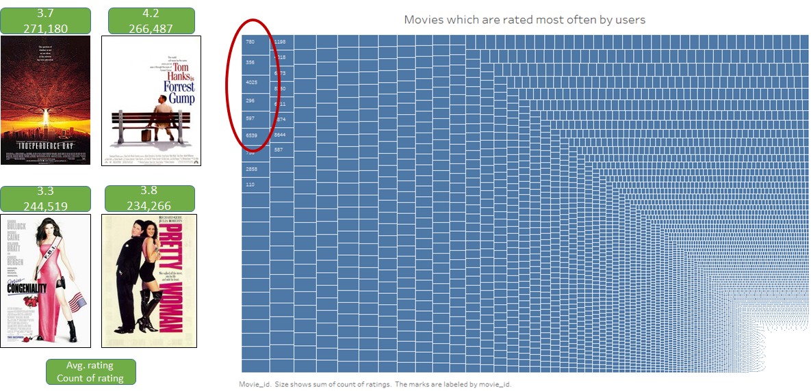
Population view - Most often rated movies and average rating
Notes:
Amod
The current movie match prototype uses Tableau for generating user analytics. For production release, the analytics can be ported to the movie match application.
There are two components to this analytics: Admin and User analytics. While we have focused on user analytics, this and next slide give a glimpse of admin level analytics.
The above dashboard shows a tree map for most often movies rated by the users and their average ratings. The tree map provides information of the movie id, name, average rating and number of times the movie was rated by the users.
Forrest Gump / Pretty Woman - no surprises there

Slide 13
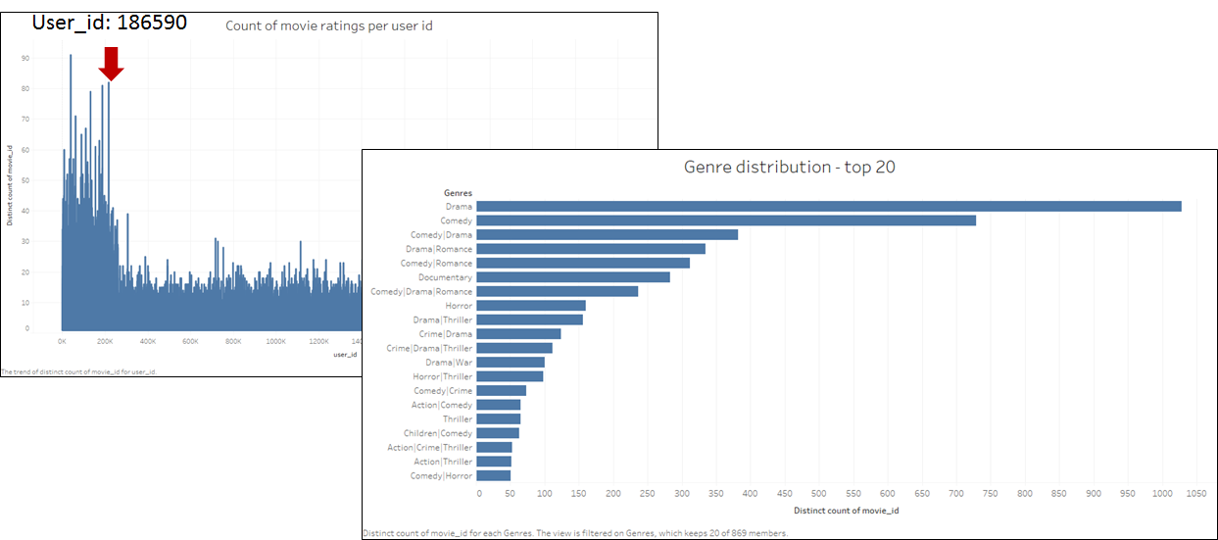
Population view - Count of ratings and Genre distribution
Notes:
Amod
Continuing on the admin dashboards, the above charts show a population view of user’s and count of movies that they have rated along with genre distribution.
Lets take a sample user (user id 186590) to do a more deep dive on user analytics

Slide 14
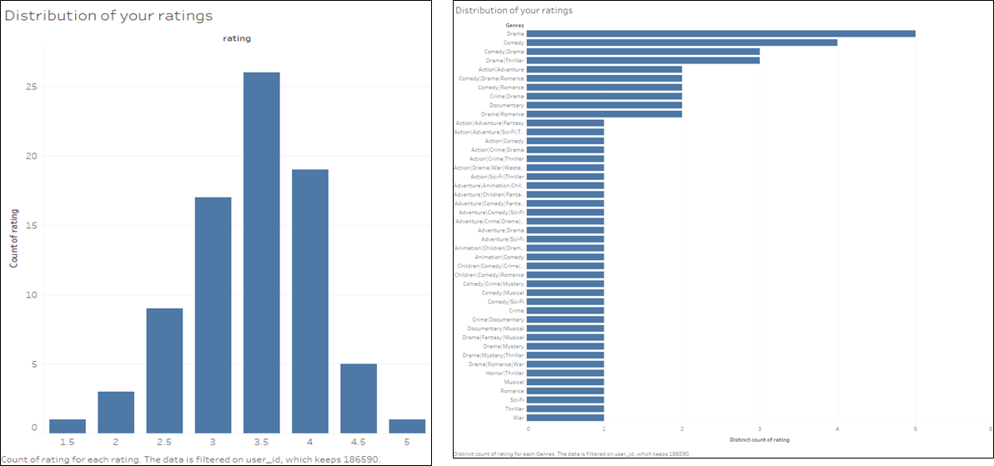
Distribution of my ratings (user id = 186590)
Notes:
Amod
We envision to make the user analytics available to each user who has an account for movie match application. Users will get a view of his/her ratings and genre distribution. The above charts are for the sample user id. The solo recommender and the futuristic group recommender that we discussed previously is based on a user profile. User ratings and genre distribution becomes one of the key components of that user profile.

Slide 15
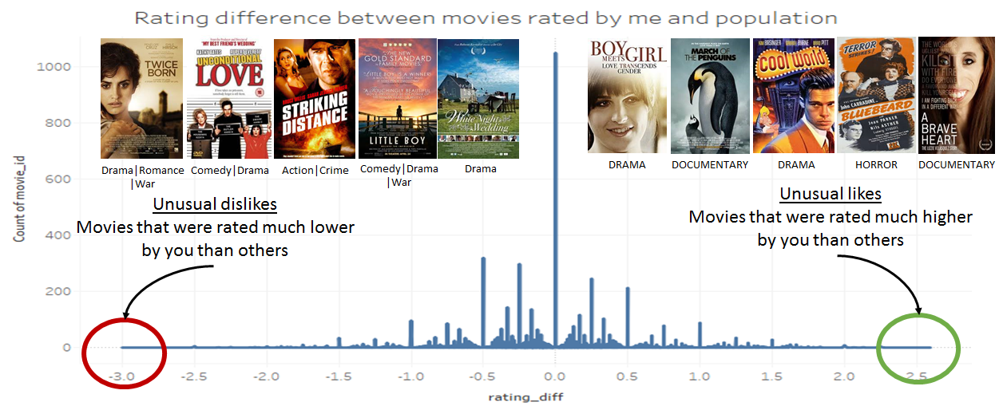
My unusual likes and dislikes
Notes:
Amod
Another interesting aspect which builds this user profile is to display to the user the unusal likes and dislikes. The unusual dislikes are the movies which are to the left of the spectrum. Those are the movies that were rated much lower by the user than others. To the right of the spectrum are unusual likes.

Slide 16
Rare movies rated by me
Notes:
Amod
Another aspect of user profile which may impact are rarely rated movies. What we see above are some of the movies rated at 5-star by this user but this movie was rated only by one other user out of a unique user size of over 2 million

Slide 17
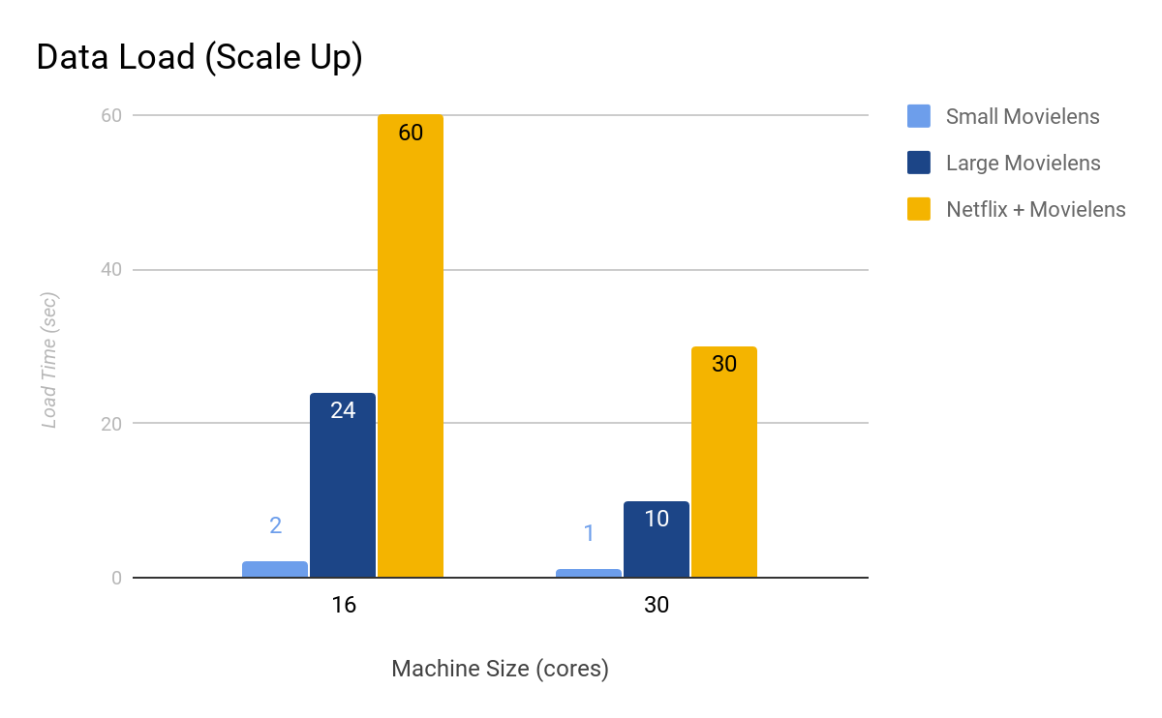
Data Load Performance
Real-time updates should be possible
Notes:
Cameron
We tried visualizing our data on neo4j and python’s networkx. We also tried to perform principal component analysis (PCA) on it to reduce the dimensionality and visualize, but ran into issues with the requirements to load everything into memory. It has been done before, though (https://flowingdata.com/2007/12/11/netflix-prize-dataset-visualization/), so it is a possibility in the future.
Feeding data back to the web server is complicated, so we haven’t done it yet. But purely from a data storage/processing point of view, it should be feasible.

Slide 18
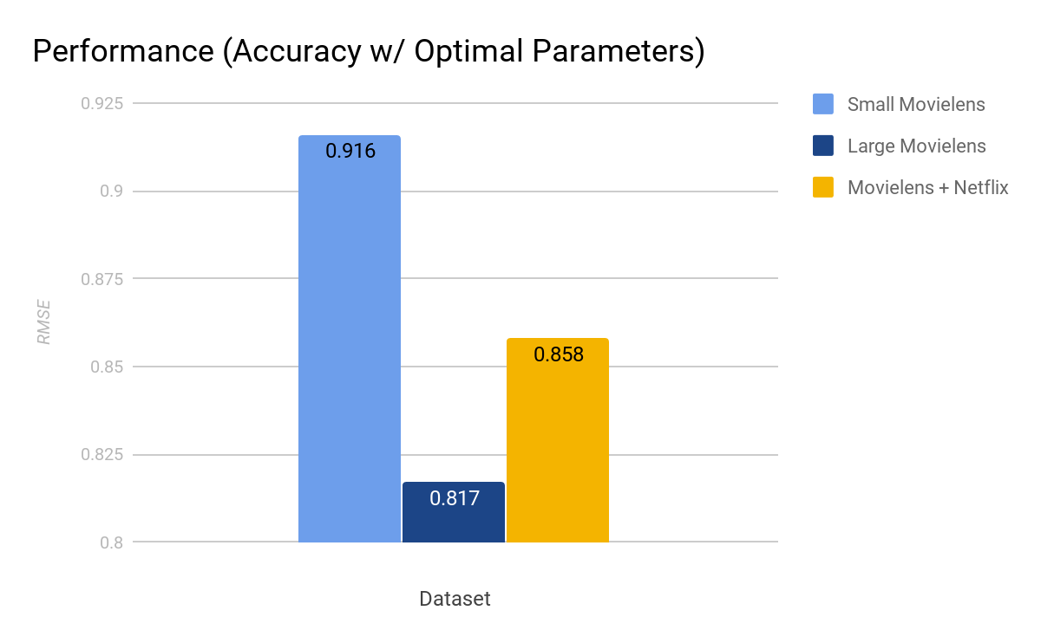
Machine Learning Performance
Hyperparameter Tuning
Grid search on small dataset
Hyperparameters: rank, iterations, lambda
Notes:
Luke

Slide 19
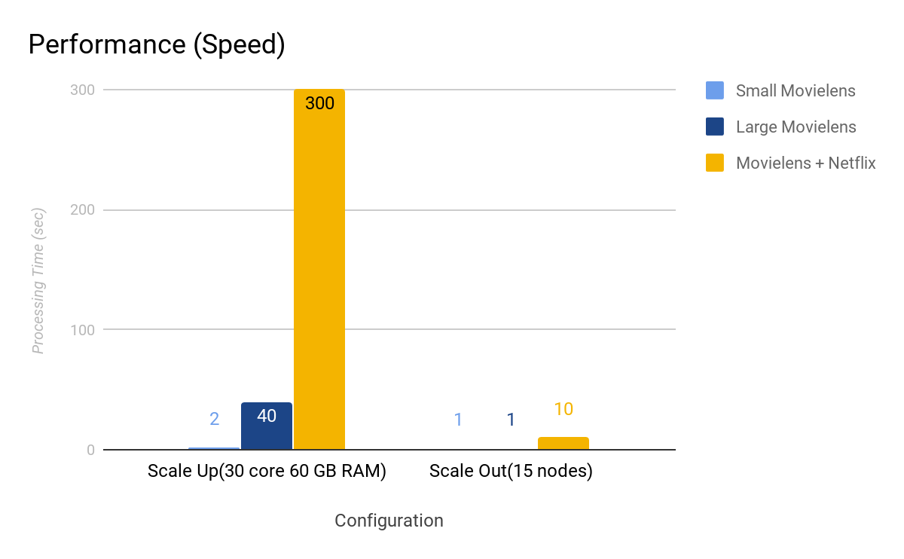
Machine Learning Performance
Notes:
Luke

