Slide 1
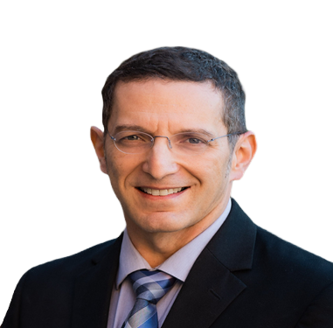
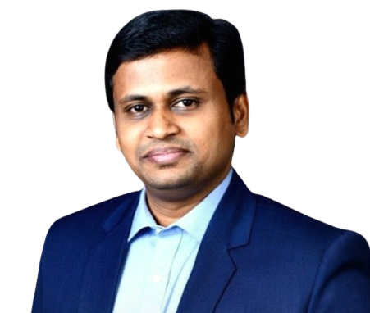
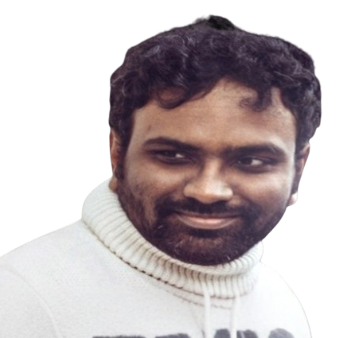
AI-Driven
MULTI-MODAL
Retrieval-Augmented Generation
for Advanced Patent Analytics
SIVAKUMAR THIYAGARAJAN
ADITYA MENGANI
VARUN NAIDU
DR. MEIR MARMOR
Data Scientist Boeing
Data Engineer Amazon
Software Engineer Boeing
Orthopedic Surgeon UCSF
https://synapsepatents.com
December 12th 2024

Slide 2
SIVAKUMAR THIYAGARAJAN
ADITYA MENGANI
VARUN NAIDU
DR. MEIR MARMOR
Data Scientist Boeing
Data Engineer Amazon
Software Engineer Boeing
Orthopedic Surgeon UCSF
AI-Driven
MULTI-MODAL
Retrieval-Augmented Generation
for Advanced Patent Analytics
December 5th 2024
https://synapsepatents.com

Slide 3
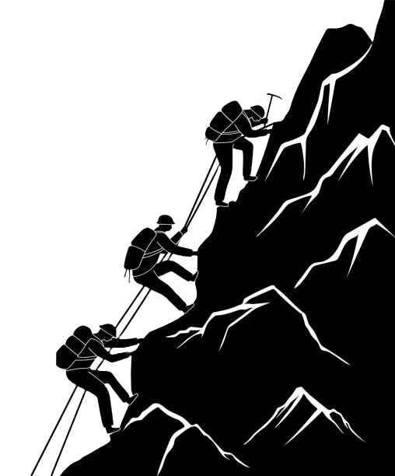
MISSION
Accelerate global innovation with advanced patent analytics
to deliver actionable patent insights, empower smarter decisions and drive intellectual property advancement

Slide 4
NOVEL
IS MY INVENTION
N VEL?

Slide 5
Growing Complexity and Technicality, and Lengthy Documents are leading to Patent Rejections
1 1 –
Not Patentable
1 2 –
Not Novel
1 3 –
Combination of Prior Art

Slide 6
PATENT INFRINGEMENT CASES
Microsoft settles Cortana patent case after $242M trial loss
Western Digital owes $315.7M for infringing data security patent, US jury says
Activision hit with $23.4M US patent verdict in multiplayer-gaming case

Slide 7
PATENT SEARCH FIRMS
ONLINE TOOLS
ATTORNEYS & LAW FIRMS
FREELANCE PROFESSIONALS
RELATED SOLUTIONS
LENS.ORG

Slide 8
ONLINE TOOLS
PATENT SEARCH FIRMS
FREELANCE PROFESSIONALS
ATTORNEYS & LAW FIRMS
RELATED SOLUTIONS
LENS.ORG

Slide 9
KEY PROBLEMS INDENTIFIED BY TARGET USERS
Identify information in images and equations
Search through a plethora of patents
Identify 101, 102 and 103 rejection risks
OUR SOLUTION
The SYNAPSE PATENTS ChatBOT (MVP)
historical SEARCH
focused SEARCH
patentability SEARCH
Tabulated list of matching patents
Up to 250 words summarization
Rejection risk identification

Slide 10
KEY PROBLEMS INDENTIFIED BY TARGET USERS
Identify information in images and equations
Search through a plethora of patents
Identify 101, 102 and 103 rejection risks
OUR SOLUTION
The SYNAPSE PATENTS ChatBOT (MVP)
historical SEARCH
focused SEARCH
patentability SEARCH
Tabulated list of matching patents
Up to 250 words summarization
Rejection risk identification

Slide 11
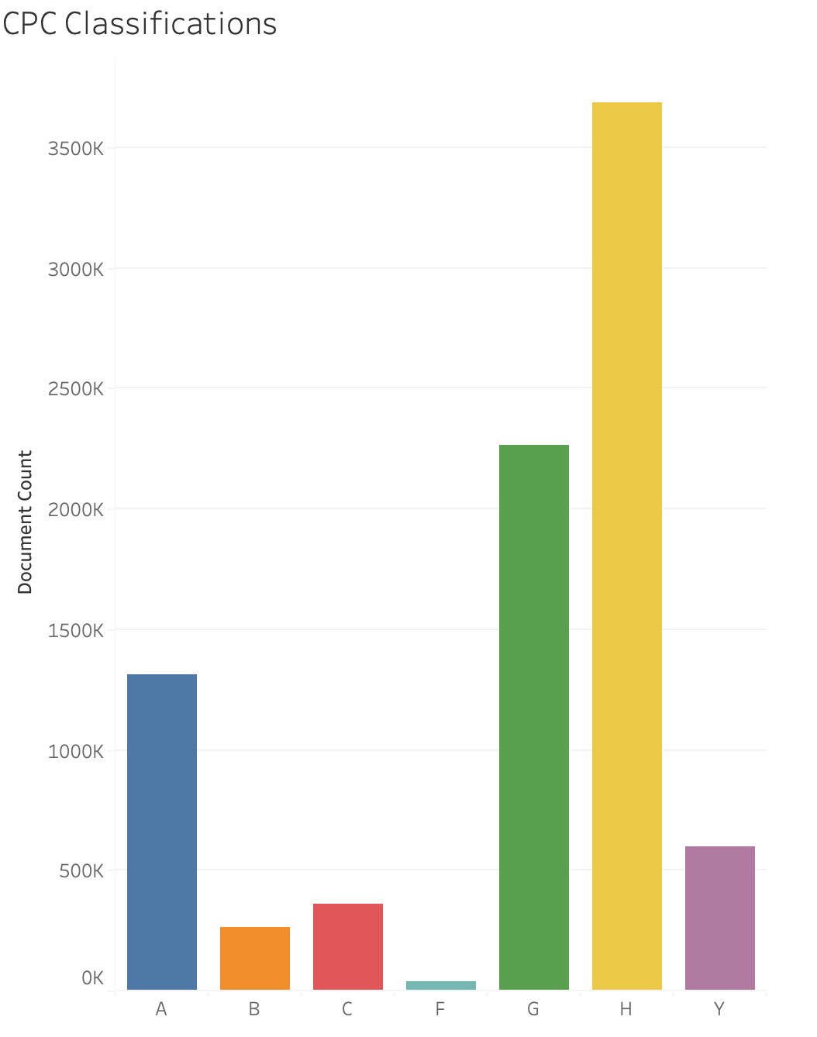
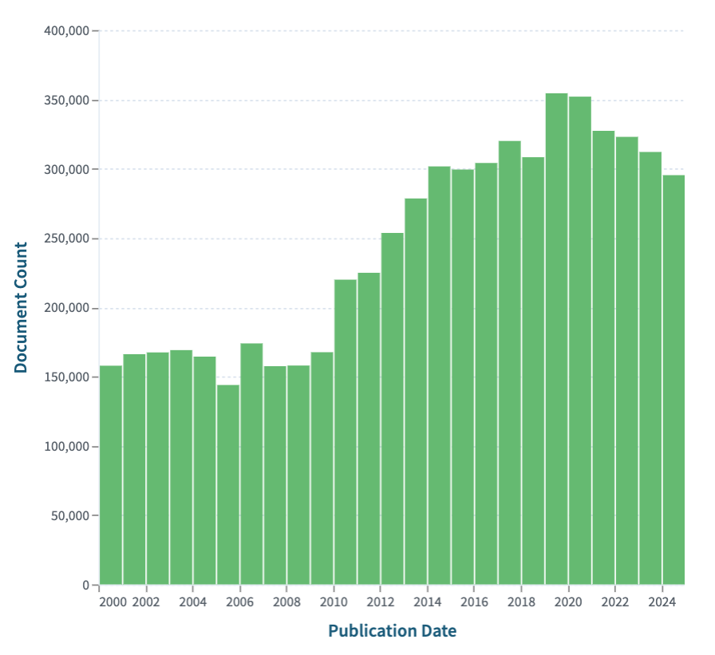
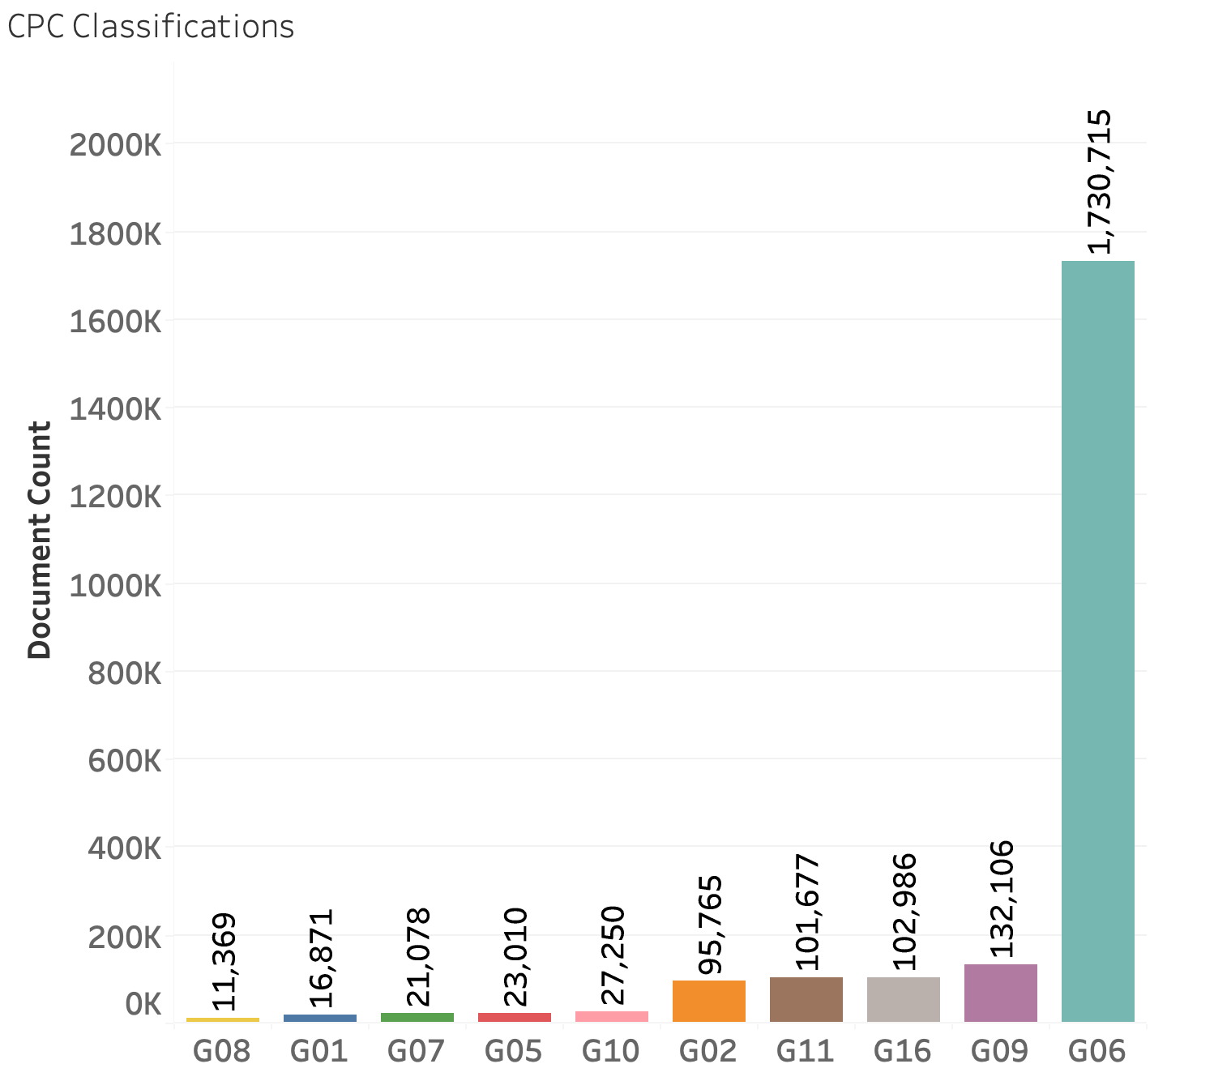
Exploratory Data Analysis
CPC - Cooperative Patent Classification
CPC Classification Codes
A - Necessities
B - Operations
C - Chemistry
D - Textiles
E - Constructions
F - Mechanical
G - Physics
H - Electricity
Most common G
G06 - Computing
G09 - Display
G16 - Information
G02 - Optics
Key Takeaways:
Data source: Google Big Query Patents
Last 10 years patents data too large for available resources (~1.2 TB)
Focus on CPC G06 classification: Jan 1 2022 - Dec 31 2023 (~170K patents published in the USA)

Slide 12
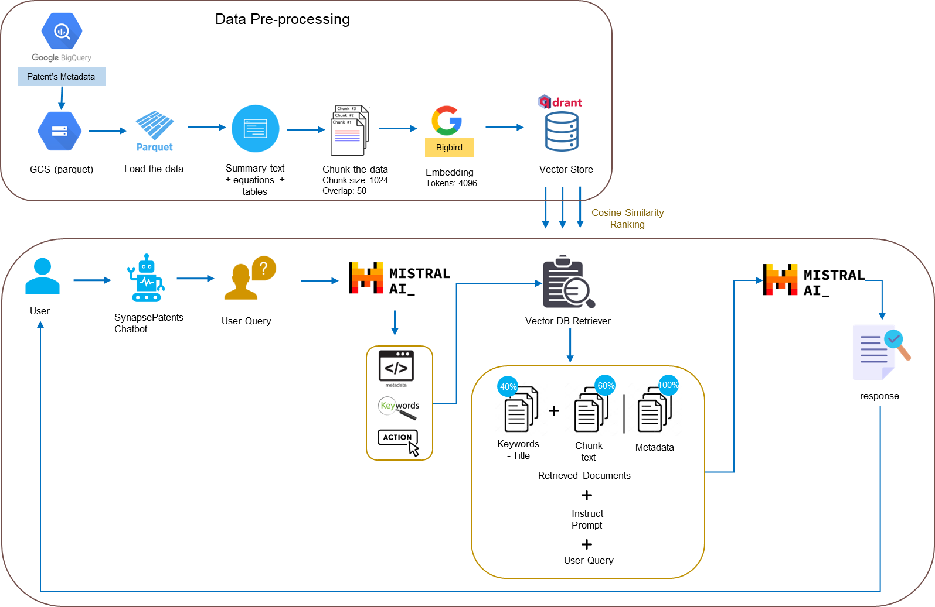
Retrieval Augmented Generation

Slide 13
EVALUATION DATASET
150 patents were chosen from the dataset at random
Keywords were generated from the Patent Abstract using ChatGPT
Keywords were passed to LENS.ORG with filters -
CPC: *G06*
Grant Date: 1st Jan 2022 to 31st Dec 2023
US Patent Office
Publication numbers of the results were saved

Slide 14
EVALUATION metrics (RAGAs)
0.15
0.35
0.25
0.25
Context Precision
Context Recall
Answer Relevancy
Faithfulness
Weighted Score

Slide 15
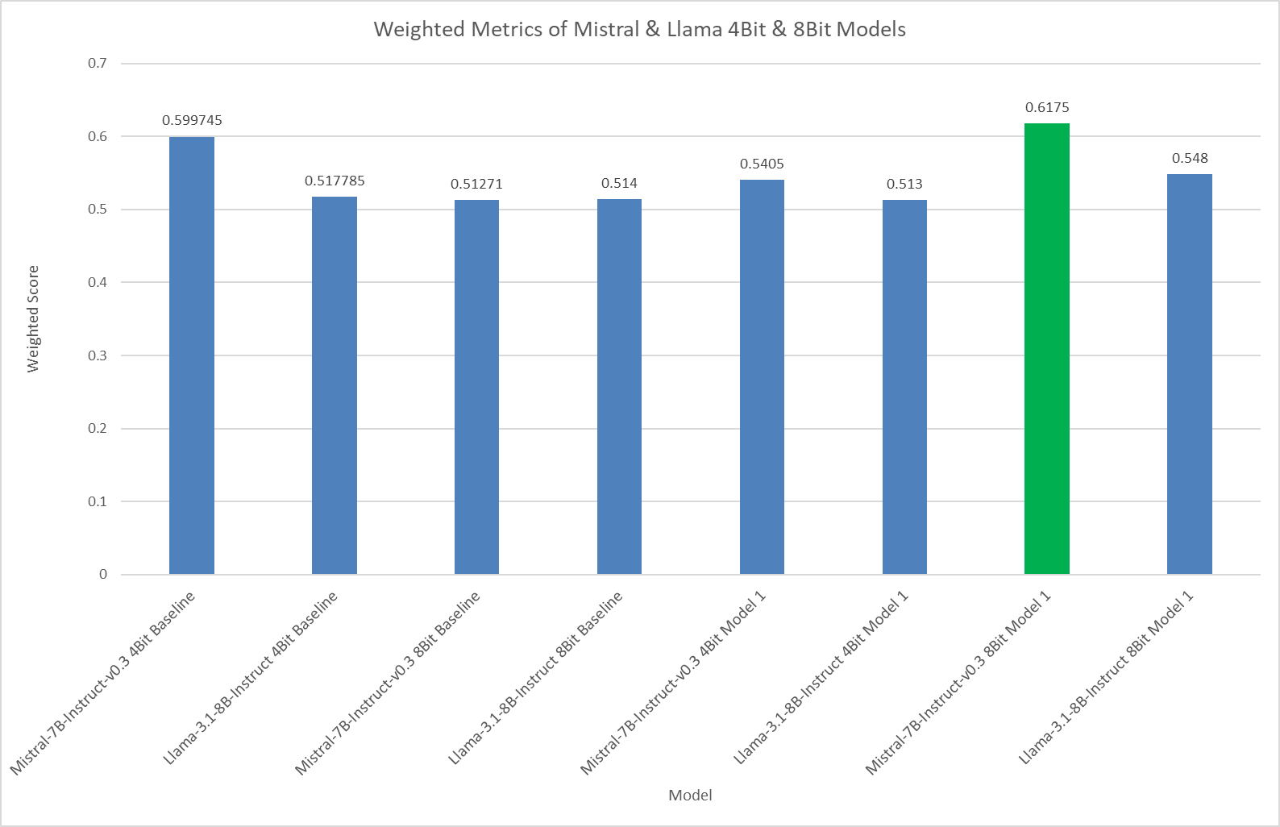
Model Card:
LLM Model: Mistral-7B-Instruct-v0.3
Quantization: 8 Bit
Embedding Model: google/bigbird-roberta-base
Chunk Size: 1024
Chunk Overlap: 50
Vector Store: QDrant
Vector Store similarity search: cosine (Top 10)
Mistral consistently follows prompt instructions, making it ideal for tasks requiring strict adherence to user input.
In contrast, Llama often draws on its pre-trained memory, even when the prompt explicitly instructs it to avoid doing so.

Slide 16
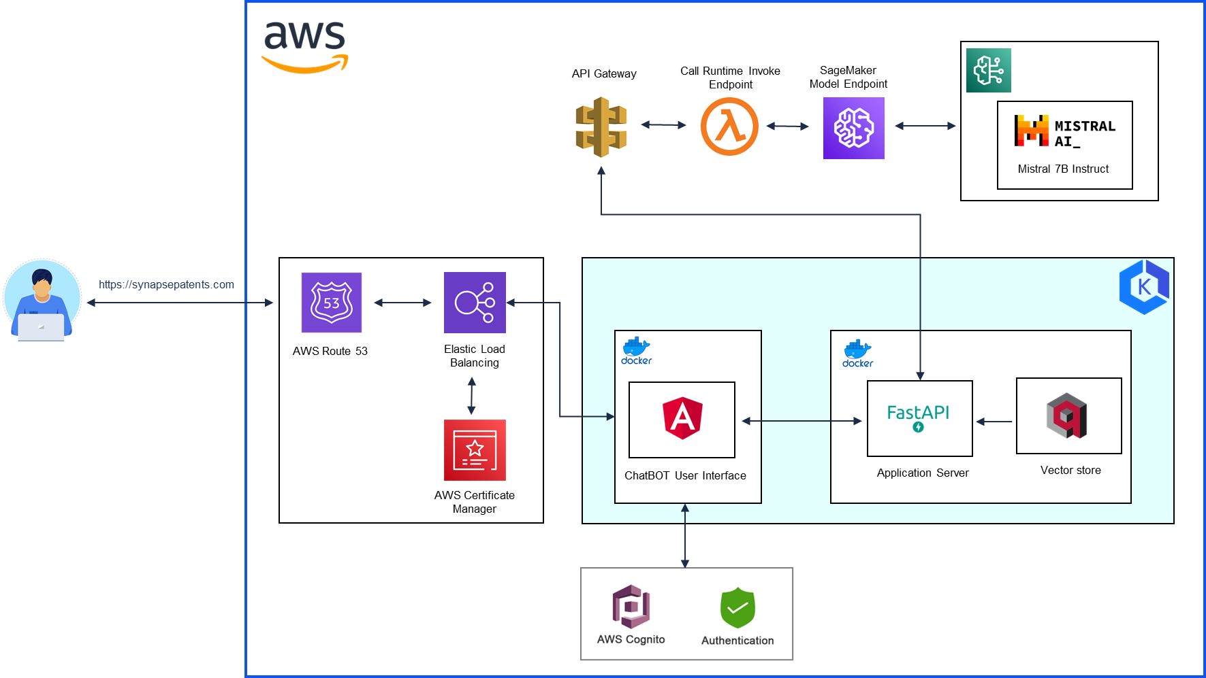
Model Deployment Architecture

Slide 18
Notes:
Link to Demo: https://youtu.be/iPrQxjfehSw

Slide 19
Key Technical takeaways
Challenges Faced
Learnings
Model Deployment in AWS
Identifying right AWS Services / Model Inference Architecture
AWS Services Costs / Compute Constraints
Patent IP search processes
Generative AI techniques
Hosting web application in AWS with domain

Slide 20
CONCLUSION
Despite challenges, this MVP of our AI-powered RAG ChatBOT has demonstrated strong potential in transforming patent searches, making them more accurate.
As the patent landscape continues to grow larger and more complex, we are confident that our product will empower organizations and individuals to stay ahead in the competitive world of innovation.
We aim to take this MVP to the next level through seed funding. Additionally, we plan to bring a subscription model for our business.

Slide 21
ACKNOWLEDGEMENTS
Capstone Instructors:
Kira Wetzel
Puya Vahabi
Subject Matter Experts:
Neal Cohen, Patent Attorney, UCSF, CA
Jay Chesavage, Freelance Patent Search Professional, CA

Slide 22
REFERENCES
Chen, W., Hu, H., Chen, X., Verga, P., & Cohen, W. W. (2022). MuRAG: Multimodal retrieval-augmented generator for open question answering over images and text. https://aclanthology.org/2022.emnlp-main.375.pdf
Aleksandra Piktus, Fabio Petroni, Vladimir Karpukhin, et. al., "Retrieval-Augmented Generation for Knowledge-Intensive NLP Tasks", Facebook AI Research; University College London; New York University. https://arxiv.org/pdf/2005.11401
Damian Gil. "Advanced Retriever Techniques to Improve Your RAGs". https://towardsdatascience.com/advanced-retriever-techniques-to-improve-your-rags-1fac2b86dd61
Llama Team, AI @ Meta. The Llama 3 Herd of Models. https://arxiv.org/pdf/2407.21783
Jiang, H., Xu, C., Liang, P., & Xiao, C. (2023). Mistral 7B: A 7-billion-parameter language model for efficient and high-performance natural language processing. arXiv preprint arXiv:2310.06825. https://arxiv.org/pdf/2310.06825
Adithya S K. (2023, October 9). Deploy Mistral/Llama 7b on AWS in 10 mins. Medium. https://adithyask.medium.com/deploy-mistral-llama-7b-on-aws-in-10-mins-cc80e88d13f2

Slide 23
THANK YOU
QUESTIONS?

Slide 24
THANK YOU
QUESTIONS?

Slide 25
APPENDIX
Functionalities of SynapsePatents Website

