Slide 1
SynapsePatents
AI-Powered Multi-Modal RAG for Advanced Patent Analytics​
Team Members: Sivakumar Thiyagarajan, Aditya M, Varun Naidu, Meir T. Marmor

Slide 2
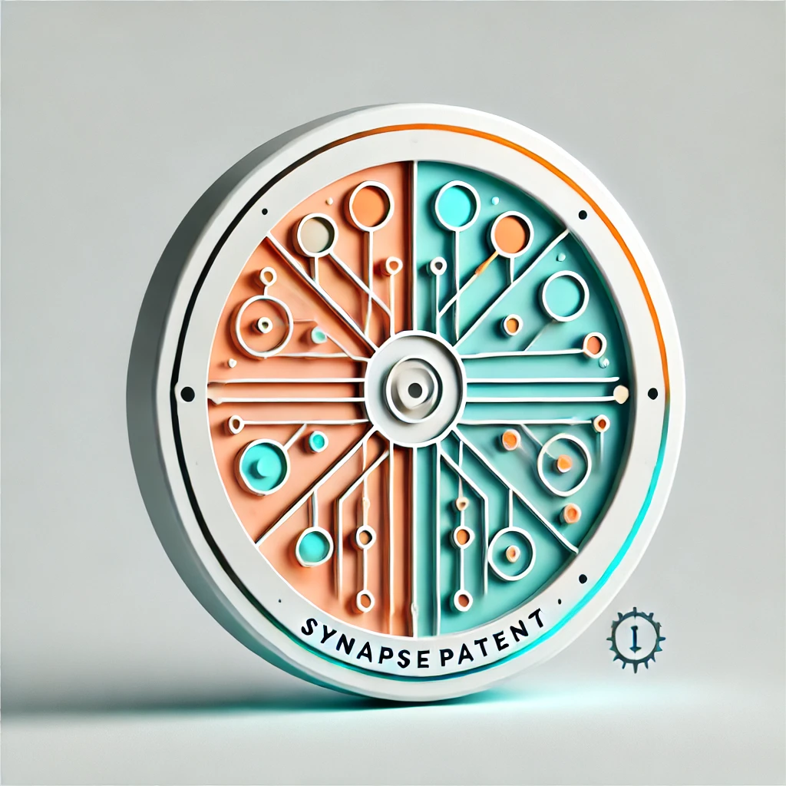
Our Mission
Accelerate Global Innovation
with Advanced Patent Analytics
Notes:
to provide valuable resources and insights that can empower businesses, researchers, and inventors to innovate more effectively and efficiently, ultimately contributing to progress in various fields.

Slide 4
The Problem with Patent Search
Growing complexity and volume
Lengthy documents with technical jargon
Difficult to understand
Existing methods - Filtering or querying limitations/difficulties
Potential for:
Costly legal disputes & infringement lawsuits
Blackberry vs. NTP (2006)
Nintendo vs. Anascape (2008)
Microsoft vs. i4i (2011)
Kodak vs. Polaroid (1986)
ZeniMax vs. Oculus (2017)
Wasted investments & missed opportunities
Notes:
The growing complexity and sheer volume of patent documents present a substantial challenge for users seeking to extract relevant information efficiently. Patent texts are often lengthy, filled with technical and legal jargons, and organized in dense formats, making it difficult for both experts and non-experts to quickly understand its key aspects. Traditional methods of information retrieval, including manual searches and keyword-based queries, are labour-intensive and inefficient, leading to significant time and cost expenditures.
Additionally, the financial risks associated with patent-related issues are considerable. Developing new technologies or products without the awareness of existing patents can lead to costly legal disputes and infringement lawsuits, which may result in substantial legal fees, fines, and potential damages. Companies may also incur significant development costs if their innovations overlap with patented technologies, leading to wasted R&D investments and missed market opportunities.

Slide 5
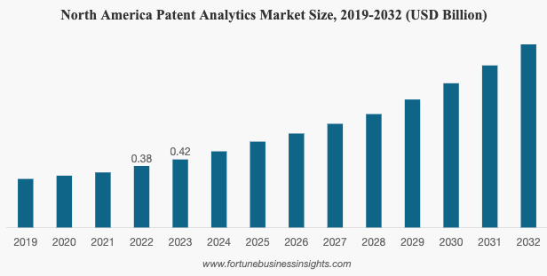
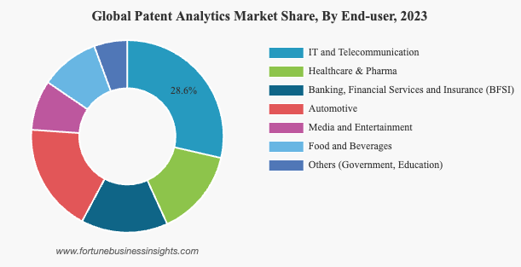
Market Potential - Patent Analytics
Patent Analytics software is costly ($1K-$5K annual fee).
Information Extraction Services can have $12K-$35K annual fee.
Patent Analytics Market Projected to grow from $1.12 to $3.02 billion by 2032 (CAGR of 13.2%)
(https://www.fortunebusinessinsights.com/patent-analytics-market-102774).

Slide 6
Target Users
“keyword searches turn up a lot of irrelevant results”
“Patent figures contain relevant structures that may be used by the present invention. “
“The real problem is 35 USC 103 rejections, where previously patented separate elements of the invention are combined to anticipate your invention.
So, a complete search has to include the individual pieces of the invention.”
IP Search Firms
R&D Teams
Individual users

Slide 7
Our Solution (Minimal Viable Product)
Q&A Chatbot to query historical patents
Pre-selection of focus areas
User-relevant responses with reference / links:
100 words summary
A table with the latest patents
Follow up prompt to check if the response is satisfactory
The chatbot also would respond if there is no specific patent found for the user query.

Slide 8
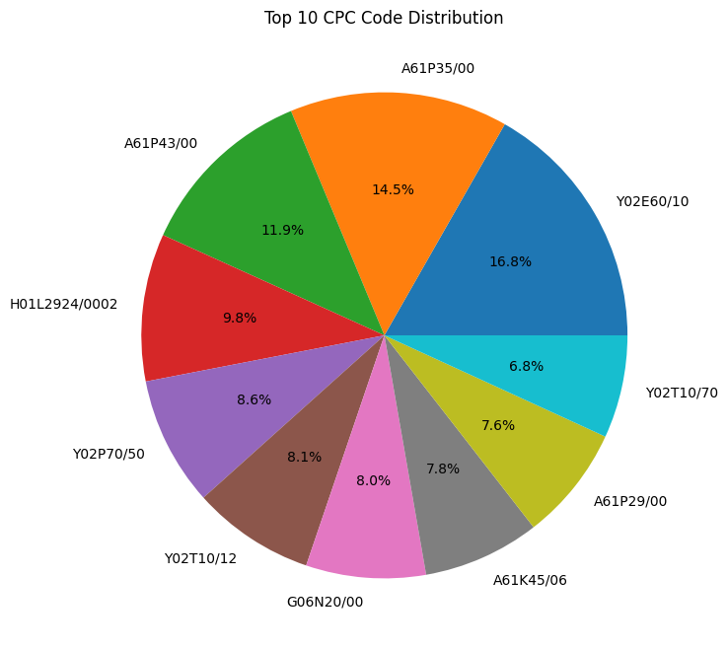
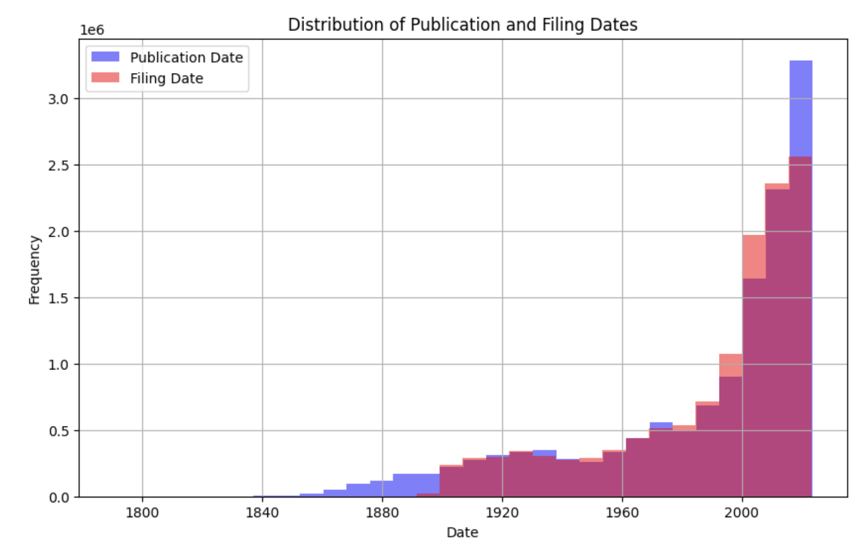
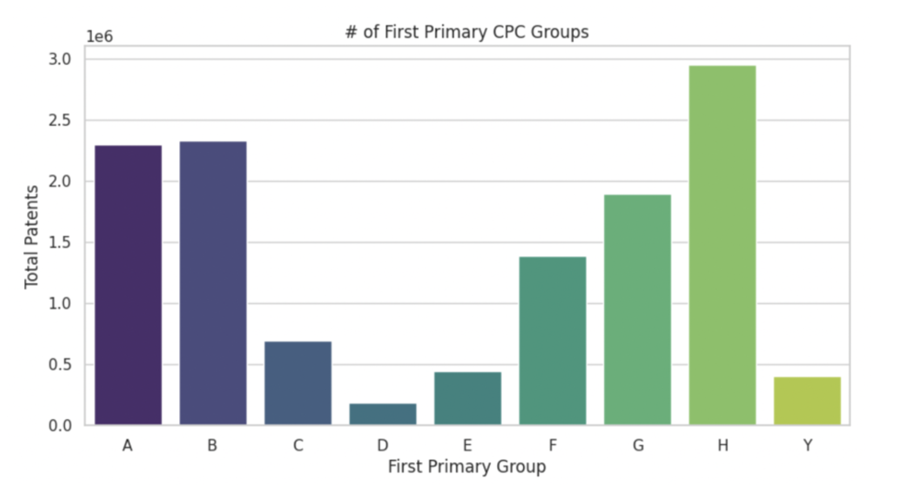
Challenge #1 - Dataset is very large
EDA
Decision:
Focus on CPC G06 classification
From Jan 1 2023 - Dec 31 2023
~87000 patents published in the USA

Slide 9
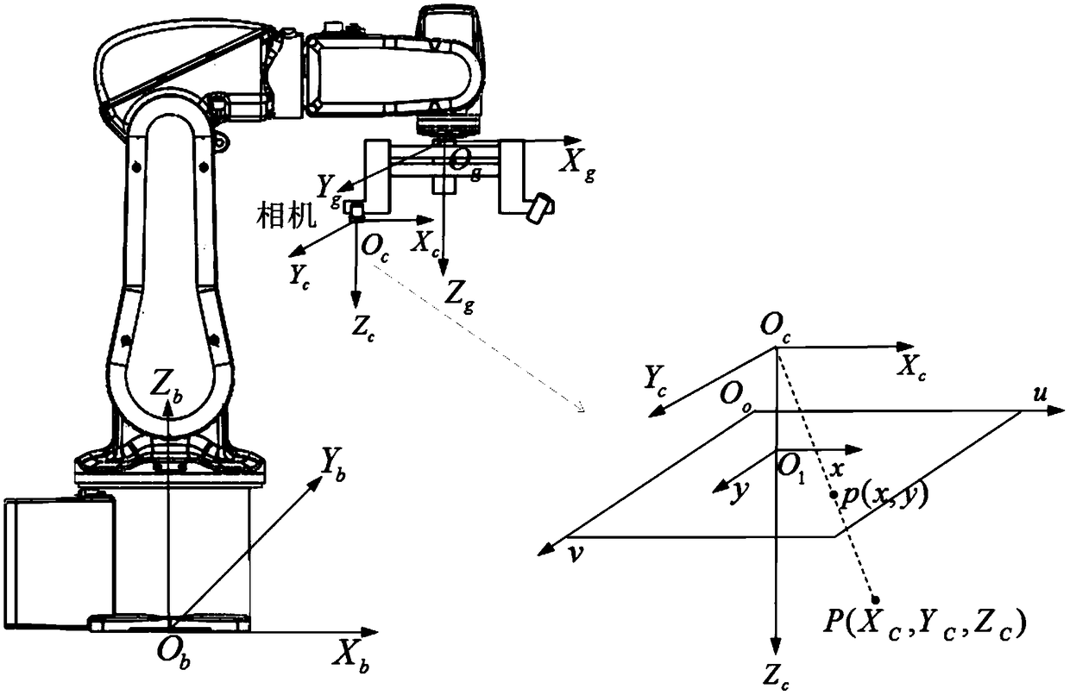
Challenge #2 - Tables and Equations
Information included in tables and equations may contain patentable components (35 USC 103 rejections)
Tokenization of this info is challenging
Solution:
Extracted the mathml format for equations in the text, passed it though a js library and converted them to latex format.
Replaced mathml text with the latex versions.
Converted tables to csv text format
Converted the html to plain text.

Slide 10
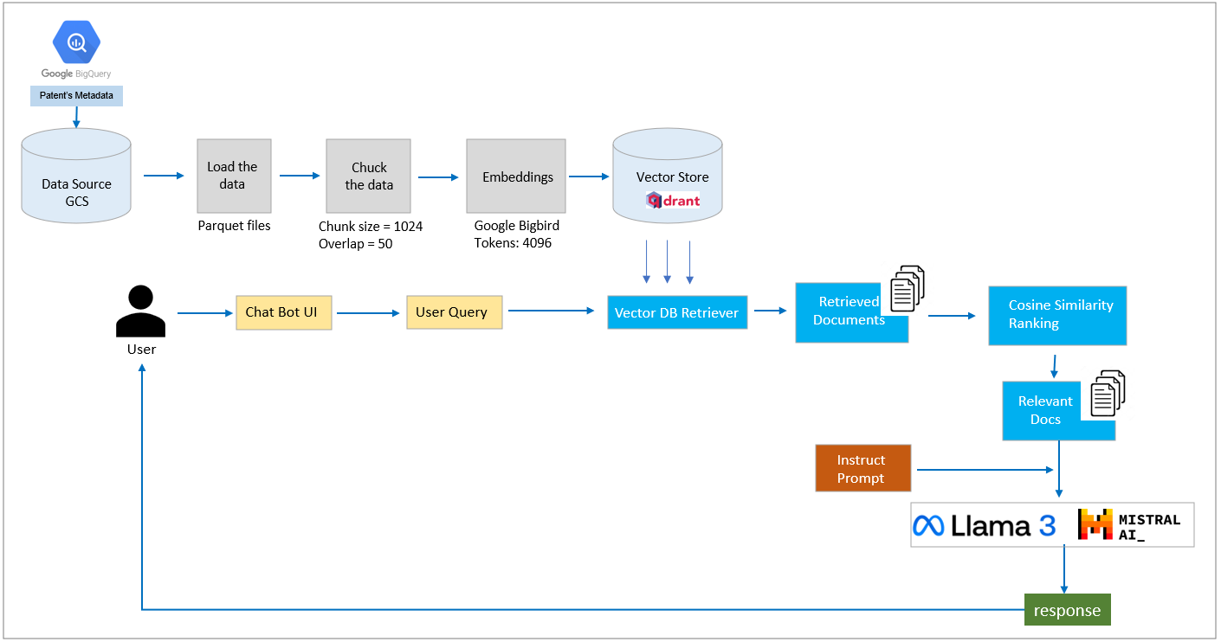
RAG Architecture

Slide 11
Challenge #3: Building Vector store for the patent documents
Qdrant Vector store
Downloaded Computing related patents from 1st Jan, 2023 to 31st Dec, 2023 into 23 parquet files each ~350 MB
Processing and vector store creation of abstract, description, claims_text took ~7 hrs
Created vector store for individual parquet files but couldn’t merge them. Spent lot of time here investigating it.
Drained lot of colab compute units & AWS credits
Decision:
Summary text from each patents
Abstract if Summary text not present
Processed 23 parquet files. Each vector store ~45MB
Qdrant stores the vectors as sqlite database.
Found a hack to merge sqlite files instead of merging quadrant collections which never finished.

Slide 12
Evaluation Data collection
Took Random 50 patents from the dataset
Generated Keywords based on Abstract using ChatGPT
Using the keywords
LENS.ORG
CPC: *G06*
Patent Grant Date: 1st Jan - 31st Dec 2023
Downloaded list of relevant patents (Publication Number)

Slide 13
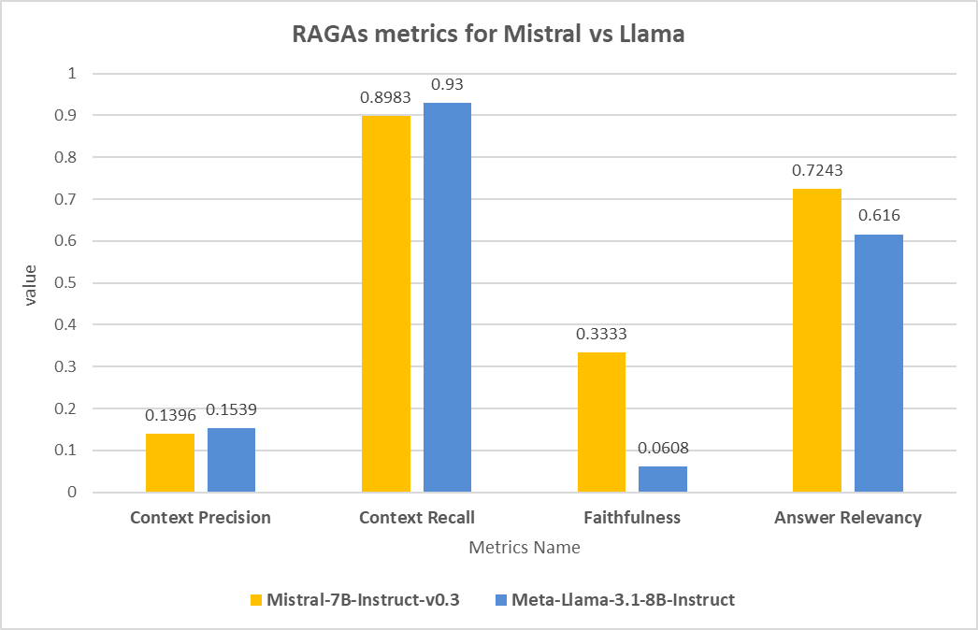
Model Evaluation
Notes:
Context Precision: It shows how much of the retrieved context is relevant to the user query.
Context Recall: It shows how much of relevant context from the vector store is retrieved.
Faithfulness: It shows the extent to which the generated answer accurately reflects the information present in the retrieved context
Answer Relevancy: It measures how well the generated answer addresses the user’s original query.

Slide 14
Tradeoffs and Feasibility
Question | Mistral Response | Llama Response | Ground Truth
Display a list of patent numbers in Python list format without anything else that is most relevant to these keywords:Location-based interaction, user data, user computing device, alert signals, communication interface | ['US-11804131-B2', 'US-11580235-B2', 'US-11707663-B1', 'US-11659221-B2', 'US-11620884-B2', 'US-11670260-B2'] | ['US-11657419-B2', 'US-11659221-B2'] ['US-11607749-B2', 'US-11485301-B2', 'US-11379191-B2', 'US-10891951-B1', 'US-10904473-B2'] ['US-11144987-B2', 'US-11031108-B2', 'US-10476445-CB1', 'US-10731394-B2', 'US-10573688-B2'] ['US-11224713-B2', 'US-10364783-B1', 'US-10651417-B2', 'US-10083544-A', 'US-10174141-B2'] ['US-11914355-B2', 'US-11840111-B2', 'US-11903029-B2', 'US-11868475-B2', 'US-12004593-B2'] | ['US-11657419-B2', 'US-11804131-B2', 'US-11755539-B2', 'US-11664295-B2', 'US-11818508-B2', 'US-11544757-B2', 'US-11707663-B1', 'US-11580235-B2', 'US-11670260-B2', 'US-11659221-B2']
Mistral most of the times follows the prompt instructions
But Llama consistently responds with information from its pre-trained memory, even when the prompt explicitly instructs it to avoid doing so.

Slide 15
Demo

Slide 17
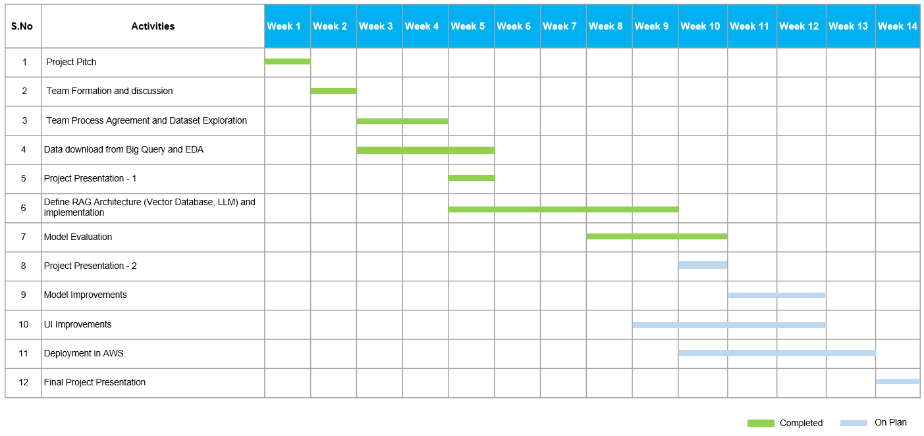
Remaining Key Areas to Tackle and Project Management

Slide 18
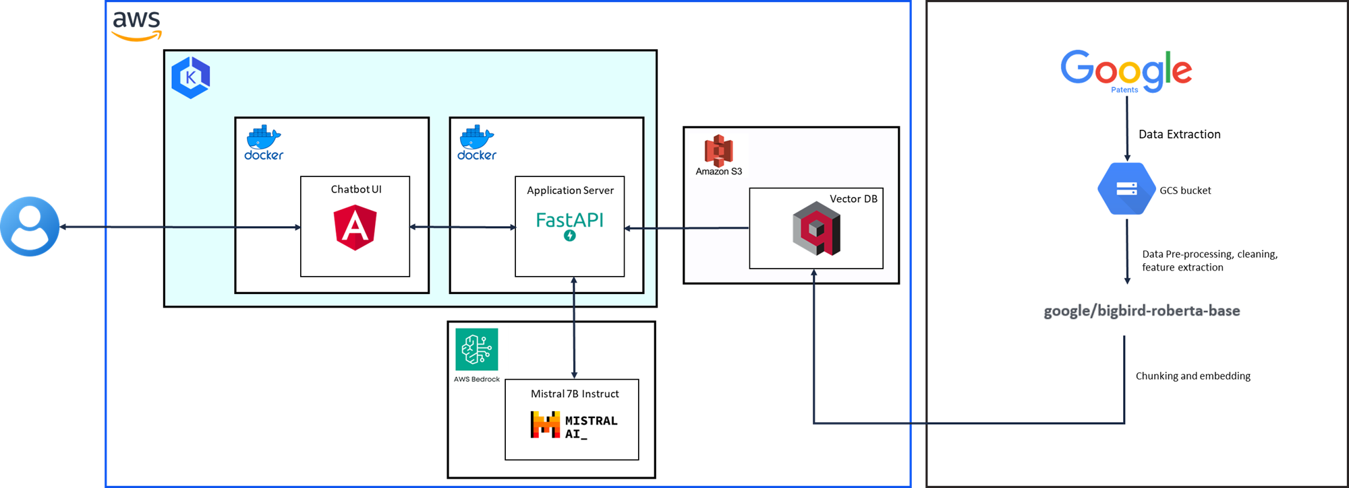
Plans for Deployment - Next steps

Slide 19
Conclusions
?
Patent searches are increasing in complexity and volume
Inadequate searches may lead to legal disputes and wanted investments
We are creating a generative AI solution for accurate and comprehensive searches
Team overcame all the challenges in creating vector store
Initial results are promising that the LLM can use the context and respond to user query.
Further efforts in fine tuning the prompt and context retrieval may improve the response
SynapsePatents

Slide 20
Our Mission
Accelerate Global Innovation
with Advanced Patent Analytics
Notes:
to provide valuable resources and insights that can empower businesses, researchers, and inventors to innovate more effectively and efficiently, ultimately contributing to progress in various fields.

Slide 21
Unused Slides

Slide 22
Market Research
All lack a Q&A system and provide lengthy analysis documents

Slide 23
Datasets
Google Patents Dataset
Downloaded 20 years of Patents metadata including abstract, title & description from Google BigQuery
The Dataset is very large (1.3 TB for just the most recent 2 years), excluding images
Narrowed down dataset by only considering patents in the Computing and Communications domain

